Slide 1
Software Testing & Quality
(01)-Introduction
陈振宇
南京大学软件学院
http://software.nju.edu.cn/zychen

Slide 2
Outline
Why
What
Who
When
Terminology
Testing Level (Maturity)
Roadblocks

Slide 3
Why

Slide 4
Testing in the 21st Century
Software defines behavior
  network routers, finance, switching networks, other infrastructure
Today’s software market :
  is much bigger
  is more competitive
  has more users
Embedded Control Applications
  airplanes, air traffic control
  ovens
  remote controllers
Agile processes put increased pressure on testers
  Programmers must unit test – with no training, education or tools !
  Tests are key to functional requirements – but who builds those tests ?

Slide 5
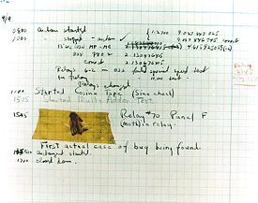
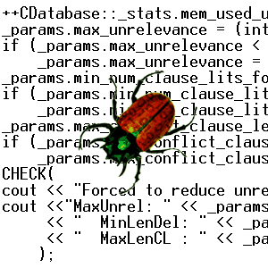

The First Bugs
Hopper’s
“bug” (moth
stuck in a
relay on an
early machine)
“It has been just so in all of my inventions. The first step is an intuition, and comes with a burst, then difficulties arise—this thing gives out and [it is] then that 'Bugs'—as such little faults and difficulties are called—show themselves and months of intense watching, study and labor are requisite. . .” – Thomas Edison

Slide 6

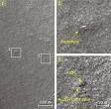
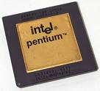
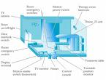
Spectacular Software Failures
NASA’s Mars lander: September 1999, crashed due to a units integration fault
Ariane 5:
exception-handling
bug : forced self
destruct on maiden
flight (64-bit to 16-bit
conversion: about
370 million $ lost)
Mars Polar
Lander crash
site?
Major failures: Ariane 5 explosion, Mars Polar Lander, Intel’s Pentium FDIV bug
THERAC-25 design
Poor testing of safety-critical software can cost lives :
  THERAC-25 radiation machine: 3 dead

Slide 7

Airbus 319 Safety Critical Software Control
Loss of autopilot
Loss of most flight deck lighting and intercom
Loss of both the commander’s and the co‑pilot’s primary flight and navigation displays !

Slide 8

Northeast Blackout of 2003
508 generating units and 256 power plants shut down
Affected 10 million people in Ontario, Canada
Affected 40 million people in 8 US states
Financial losses of
$6 Billion USD
The alarm system in the energy management system failed due to a software error and operators were not informed of the power overload in the system

Slide 9
安全关键软件故障
● 2012年11月，美国福特公司召回8.9万辆汽车，原因是汽车冷却系统的监控软件存在故障，会导致发动机在运行时产生过热现象，并已至少发生了9起由此引起的汽车失火事故；
● 2011年7月23日，“甬温线”动车追尾事故造成40人死亡、172人受伤。事故的主要原因之一是列控中心设备中的自检模块软件存在严重设计缺陷，未将系统导向安全侧；
● 2007年10月16日，发生在德国弗鲁蒂根（Frutigen）地区的勒奇山基底隧道（Lötschberg-Basistunnel）附近的列车脱轨事故。该脱轨事故是由于ETCS-2级列控系统无线闭塞中心（RBC）接入时一个与列车移动授权延伸的相关软件错误而引起的。
● 2004年9月，由于空管软件中的时钟管理缺陷，美国洛杉矶机场400余架飞机与机场指挥一度失去联系，给几万名旅客的生命安全造成严重威胁；

Slide 10
Costly Software Failures
NIST report, “The Economic Impacts of Inadequate Infrastructure for Software Testing” (2002)
  Inadequate software testing costs the US alone between $22 and $59 billion annually
  Better approaches could cut this amount in half
Huge losses due to web application failures
  Financial services : $6.5 million per hour (just in USA!)
  Credit card sales applications : $2.4 million per hour (in USA)
In Dec 2006, amazon.com’s BOGO offer turned into a double discount
2007 : Symantec says that most security vulnerabilities are due to faulty software

Slide 11


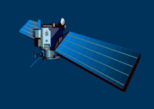
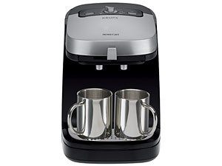



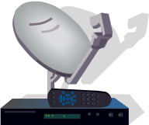
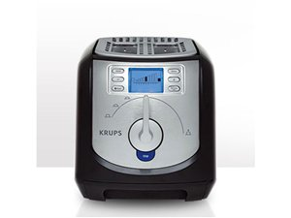





Software Surrounds Our Civilization
Quote due to Dr. Mark Harman

Slide 12
Testing in the 21st Century
More safety critical, real-time software
Embedded software is ubiquitous … check your pockets
Enterprise applications means bigger programs, more users
Paradoxically, free software increases our expectations !
Security is now all about software faults
  Secure software is reliable software
The web offers a new deployment platform
  Very competitive and very available to more users
  Web apps are distributed
  Web apps must be highly reliable

Slide 13
Why Test?
If you don’t know why you’re conducting each test, it won’t be very helpful
Written test objectives and requirements must be documented
What are your planned coverage levels?
How much testing is enough?
Common objective – spend the budget … test until the ship-date …
  Sometimes called the “date criterion”

Slide 14
Cost of Not Testing
Program Managers often say: “Testing is too expensive.”
Not testing is even more expensive
Planning for testing after development is prohibitively expensive
A test station for circuit boards costs half a million dollars …
Software test tools cost less than $10,000 !!!

Slide 15
What

Slide 16

Test Design in Context
Test Design is the process of designing input values that will effectively test software
Test design is one of several activities for testing software
  Most mathematical
  Most technically challenging
http://www.cs.gmu.edu/~offutt/softwaretest/

Slide 17
Types of Test Activities
Testing can be broken up into four general types of activities
  Test Design
  Test Automation
  Test Execution
  Test Evaluation
Each type of activity requires different skills, background knowledge, education and training
No reasonable software development organization uses the same people for requirements, design, implementation, integration and configuration control
    1.a) Criteria-based
    1.b) Human-based
Why do test organizations still use the same people for all four test activities??

Slide 18
1. Test Design – (a) Criteria-Based
Design test values to satisfy coverage criteria or other engineering goal
This is the most technical job in software testing
Requires knowledge of :
  Discrete math
  Programming
  Testing
Requires much of a traditional SE degree
This is intellectually stimulating, rewarding, and challenging
Test design is analogous to software architecture on the development side
Using people who are not qualified to design tests is a sure way to get ineffective tests

Slide 19
1. Test Design – (b) Human-Based
Design test values based on domain knowledge of the program and human knowledge of testing
This is much harder than it may seem to developers
Criteria-based approaches can be blind to special situations
Requires knowledge of :
  Domain, testing, and user interfaces
Requires almost no traditional SE
  A background in the domain of the software is essential
  An empirical background is very helpful (biology, psychology, …)
  A logic background is very helpful (law, philosophy, math, …)
This is intellectually stimulating, rewarding, and challenging
  But not to typical SE majors – they want to solve problems and build things

Slide 20
2. Test Automation
Embed test values into executable scripts
This is slightly less technical
Requires knowledge of programming
  Fairly straightforward programming – small pieces and simple algorithms
Requires very little theory
Very boring for test designers
Programming is out of reach for many domain experts
Who is responsible for determining and embedding the expected outputs ?
  Test designers may not always know the expected outputs
  Test evaluators need to get involved early to help with this

Slide 21
3. Test Execution
Run tests on the software and record the results
This is easy – and trivial if the tests are well automated
Requires basic computer skills
  Interns
  Employees with no technical background
Asking qualified test designers to execute tests is a sure way to convince them to look for a development job
If, for example, GUI tests are not well automated, this requires a lot of manual labor
Test executors have to be very careful and meticulous with bookkeeping

Slide 22
4. Test Evaluation
Evaluate results of testing
This is much harder than it may seem
Requires knowledge of :
  Domain
  Testing
  User interfaces and psychology
Usually requires almost no traditional SE
  A background in the domain of the software is essential
  An empirical background is very helpful (biology, psychology, …)
  A logic background is very helpful (law, philosophy, math, …)
This is intellectually stimulating, rewarding, and challenging
  But not to typical SE majors – they want to solve problems and build things

Slide 23
Other Activities
Test management : Sets policy, organizes team, interfaces with development, chooses criteria, decides how much automation is needed, …
Test maintenance : Save tests for reuse as software evolves
  Requires cooperation of test designers and automators
  Deciding when to trim the test suite is partly policy and partly technical – and in general, very hard !
  Tests should be put in configuration control
Test documentation : All parties participate
  Each test must document “why” – criterion and test requirement satisfied or a rationale for human-designed tests
  Ensure traceability throughout the process
  Keep documentation in the automated tests

Slide 24
Types of Test Activities – Summary
1a. | Design | Design test values to satisfy engineering goals
 | Criteria | Requires knowledge of discrete math, programming and testing
1b. | Design | Design test values from domain knowledge and intuition
 | Human | Requires knowledge of domain, UI, testing
2. | Automation | Embed test values into executable scripts
 |  | Requires knowledge of scripting
3. | Execution | Run tests on the software and record the results
 |  | Requires very little knowledge
4. | Evaluation | Evaluate results of testing, report to developers
 |  | Requires domain knowledge

Slide 25
Who

Slide 26
Test Engineer & Test Managers
Test Engineer : An IT professional who is in charge of one or more technical test activities
  designing test inputs
  producing test values
  running test scripts
  analyzing results
  reporting results to developers and managers
Test Manager : In charge of one or more test engineers
  sets test policies and processes
  interacts with other managers on the project
  otherwise helps the engineers do their work

Slide 27
Organizing the Team
A mature test organization needs only one test designer to work with several test automators, executors and evaluators
Improved automation will reduce the number of test executors
  Theoretically to zero … but not in practice
Putting the wrong people on the wrong tasks leads to inefficiency, low job satisfaction and low job performance
  A qualified test designer will be bored with other tasks and look for a job in development
  A qualified test evaluator will not understand the benefits of test criteria
Test evaluators have the domain knowledge, so they must be free to add tests that “blind” engineering processes will not think of
The four test activities are quite different
Many test teams use the same people for ALL FOUR activities !!

Slide 28
Using MDTD in Practice
This approach lets one test designer do the math
Then traditional testers and programmers can do their parts
  Find values
  Automate the tests
  Run the tests
  Evaluate the tests
  Just like in traditional engineering … an engineer constructs models with calculus, then gives direction to carpenters, electricians, technicians, …
Testers isn’t mathematicians !

Slide 29
Model-Driven Test Design
refined requirements / test specs
model / structure
test requirements
test requirements
DESIGN
ABSTRACTION
LEVEL
IMPLEMENTATION
ABSTRACTION
LEVEL
software artifact
input values
pass / fail
test results
test scripts
test cases

Slide 30
Model-Driven Test Design
criterion
refine
refined requirements / test specs
model / structure
test requirements
generate
analysis
test requirements
domain analysis
DESIGN
ABSTRACTION
LEVEL
IMPLEMENTATION
ABSTRACTION
LEVEL
software artifact
input values
feedback
evaluate
execute
automate
prefix
postfix
expected
pass / fail
test results
test scripts
test cases

Slide 31
When

Slide 32
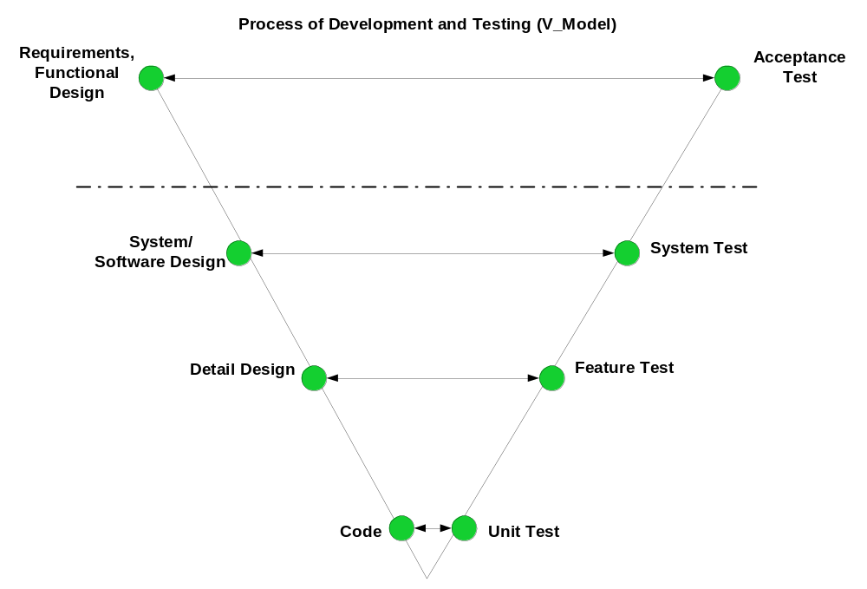
V Model
Validate requirements
customer, user, PM, technical support
Verify design
Engineers
Design/Analysis
Verify/testing

Slide 33
Testing Level
Unit Testing
Integration Testing
System Testing
Acceptance Testing

Slide 34
Testing at Different Levels
Acceptance testing: Is the software acceptable to the user?
main Class P
System testing: Test the overall functionality of the system
Class A
Class B
Integration testing: Test how modules interact with each other
method mA1()
method mB1()
method mA2()
method mB2()
Module testing: Test each class, file, module or component
Unit testing: Test each unit (method) individually
This view obscures underlying similarities

Slide 35
Test Activities
Software requirements
Define test objectives (criteria)
Project test plan
Design system tests
Design acceptance tests
Design usability test, if appropriate
System design
Specify system tests
Integration and unit test plans
Acquire test support tools
Determine class integration order
Intermediate design
Detailed design
Create tests or test specifications

Slide 36
Test Activities
Implementation
Create tests
Run tests when units are ready
Integration
Run integration tests
Apply system test
Apply acceptance tests
Apply usability tests
System deployment
Operation and maintenance
Capture user problems
Perform regression testing

Slide 37
Terminology

Slide 38
Important Terms
Validation & Verification (IEEE)
Validation : The process of evaluating software at the end of software development to ensure compliance with intended usage
Verification : The process of determining whether the products of a given phase of the software development process fulfill the requirements established during the previous phase
IV&V stands for “independent verification and validation”

Slide 39
Testing & Quality Assurance (QA)
The goal of testing is to find bugs, find them as early as possible, and make sure they are fixed.
The goal of a QA person is to create and enforce standards and methods to improve the development process so that bugs are prevented.

Slide 40
Static and Dynamic Testing
Static Testing : Testing without executing the program
  This include software inspections and some forms of analyses
  Very effective at finding certain kinds of problems – especially “potential” faults, that is, problems that could lead to faults when the program is modified
Dynamic Testing : Testing by executing the program with real inputs

Slide 41
Software Faults, Errors & Failures
Software Fault : A static defect in the software
Software Failure : External, incorrect behavior with respect to the requirements or other description of the expected behavior
Software Error : An incorrect internal state that is the manifestation of some fault
Faults in software are equivalent to design mistakes in hardware.
They were there at the beginning and do not “appear” when a part wears out.

Slide 42
Testing & Debugging
Testing : Finding inputs that cause the software to fail
Debugging : The process of finding a fault given a failure
Introduction to Software Testing (Ch 1)
© Ammann & Offutt

Slide 43
Fault & Failure Model
Three conditions necessary for a failure to be observed
Reachability : The location or locations in the program that contain the fault must be reached
Infection : The state of the program must be incorrect
Propagation : The infected state must propagate to cause some output of the program to be incorrect

Slide 44
Test Case
Test Case Values : The values that directly satisfy one test requirement
Expected Results : The result that will be produced when executing the test if the program satisfies it intended behavior

Slide 45
Observability and Controllability
Software Observability : How easy it is to observe the behavior of a program in terms of its outputs, effects on the environment and other hardware and software components
  Software that affects hardware devices, databases, or remote files have low observability
Software Controllability : How easy it is to provide a program with the needed inputs, in terms of values, operations, and behaviors
  Easy to control software with inputs from keyboards
  Inputs from hardware sensors or distributed software is harder
  Data abstraction reduces controllability and observability

Slide 46
Inputs to Affect Controllability and Observability
Prefix Values : Any inputs necessary to put the software into the appropriate state to receive the test case values
Postfix Values : Any inputs that need to be sent to the software after the test case values
Two types of postfix values
  Verification Values : Values necessary to see the results of the test case values
  Exit Commands : Values needed to terminate the program or otherwise return it to a stable state
Executable Test Script : A test case that is prepared in a form to be executed automatically on the test software and produce a report
Introduction to Software Testing (Ch 1)
© Ammann & Offutt

Slide 47
White-box and Black-box Testing
Black-box testing : Deriving tests from external descriptions of the software, including specifications, requirements, and design
White-box testing : Deriving tests from the source code internals of the software, specifically including branches, individual conditions, and statements
Model-based testing : Deriving tests from a model of the software (such as a UML diagram)
MDTD makes these distinctions less important.
The more general question is: from what level of abstraction to we derive tests?

Slide 48
Top-Down and Bottom-Up Testing
Top-Down Testing : Test the main procedure, then go down through procedures it calls, and so on
Bottom-Up Testing : Test the leaves in the tree (procedures that make no calls), and move up to the root.
  Each procedure is not tested until all of its children have been tested

Slide 49
Testing Levels Based on Test Process Maturity
Level 0 : There’s no difference between testing and debugging
Level 1 : The purpose of testing is to show correctness
Level 2 : The purpose of testing is to show that the software doesn’t work
Level 3 : The purpose of testing is not to prove anything specific, but to reduce the risk of using the software
Level 4 : Testing is a mental discipline that helps all IT professionals develop higher quality software

Slide 50
Level 0 Thinking
Testing is the same as debugging
Does not distinguish between incorrect behavior and mistakes in the program
Does not help develop software that is reliable or safe
This is what we teach undergraduate SE majors

Slide 51
Level 1 Thinking
Purpose is to show correctness
Correctness is impossible to achieve
What do we know if no failures?
  Good software or bad tests?
Test engineers have no:
  Strict goal
  Real stopping rule
  Formal test technique
  Test managers are powerless
This is what hardware engineers often expect

Slide 52
Level 2 Thinking
Purpose is to show failures
Looking for failures is a negative activity
Puts testers and developers into an adversarial relationship
What if there are no failures?
This describes most software companies.
How can we move to a team approach ??

Slide 53
Level 3 Thinking
Testing can only show the presence of failures
Whenever we use software, we incur some risk
Risk may be small and consequences unimportant
Risk may be great and the consequences catastrophic
Testers and developers work together to reduce risk
This describes a few “enlightened” software companies

Slide 54
Level 4 Thinking
A mental discipline that increases quality
Testing is only one way to increase quality
Test engineers can become technical leaders of the project
Primary responsibility to measure and improve software quality
Their expertise should help the developers
This is the way “traditional” engineering works

Slide 55
How to Improve Testing ?
Testers need more and better software tools
Testers need to adopt practices and techniques that lead to more efficient and effective testing
  More education
  Different management organizational strategies
Testing / QA teams need more technical expertise
  Developer expertise has been increasing dramatically
Testing / QA teams need to specialize more
  This same trend happened for development in the 1990s

Slide 56
Four Roadblocks to Adoption
Lack of test education
  Bill Gates says half of MS engineers are testers, programmers spend half their time testing
Necessity to change process
  Adoption of many test techniques and tools require changes in development process
  This is very expensive for most software companies
Usability of tools
Many testing tools require the user to know the underlying theory to use them
Do we need to know how an internal combustion engine works to drive ?
Do we need to understand parsing and code generation to use a compiler ?
4. Weak and ineffective tools
Most test tools don’t do much – but most users do not realize they could be better
Few tools solve the key technical problem – generating test values automatically

Slide 57
Needs From Researchers
Isolate : Invent processes and techniques that isolate the theory from most test practitioners
Disguise : Discover engineering techniques, standards and frameworks that disguise the theory
Embed : Theoretical ideas in tools
Experiment : Demonstrate economic value of criteria-based testing and ATDG (ROI)
  Which criteria should be used and when ?
  When does the extra effort pay off ?
Integrate high-end testing with development

Slide 58
Needs From Educators
Disguise theory from engineers in classes
Omit theory when it is not needed
Restructure curriculum to teach more than test design and theory
  Test automation
  Test evaluation
  Human-based testing
  Test-driven development

Slide 59
Changes in Practice
Reorganize test and QA teams to make effective use of individual abilities
  One math-head can support many testers
Retrain test and QA teams
  Use a process like MDTD
  Learn more testing concepts
Encourage researchers to embed and isolate
  We are very responsive to research grants
Get involved in curricular design efforts through industrial advisory boards

Slide 60
Future of Software Testing
Increased specialization in testing teams will lead to more efficient and effective testing
Testing and QA teams will have more technical expertise
Developers will have more knowledge about testing and motivation to test better
Agile processes put testing first—putting pressure on both testers and developers to test better
Testing and security are starting to merge
We will develop new ways to test connections within software-based systems

Slide 61

Q & A

